Slide 1
CITIZENSHIP TRAINING MODULE 1

Slide 2
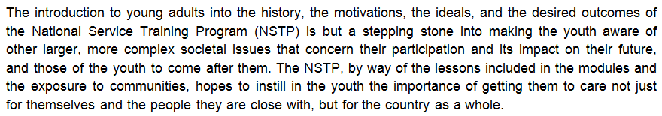
OVERVIEW

Slide 3
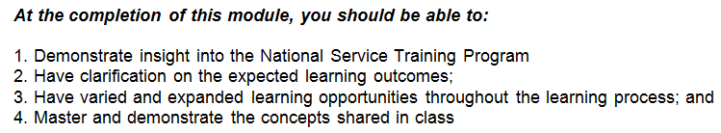
OVERVIEW

Slide 4
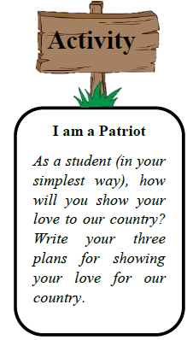





LESSON 1: HISTORICAL & LEGAL BASES OF NSTP

Slide 5

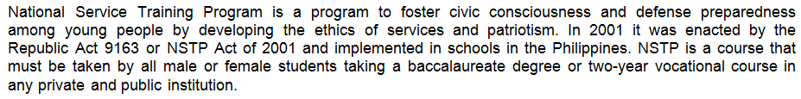

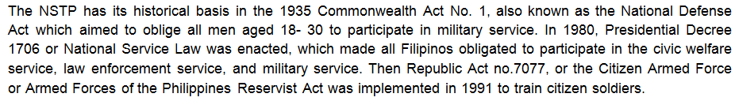
LESSON 1: HISTORICAL & LEGAL BASES OF NSTP

Slide 6
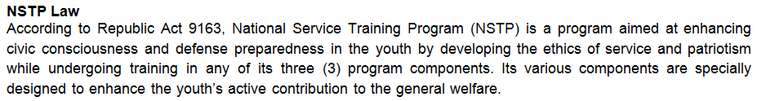
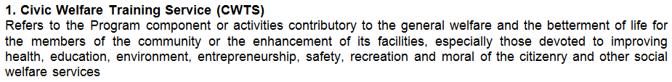
LESSON 1: HISTORICAL & LEGAL BASES OF NSTP

Slide 7
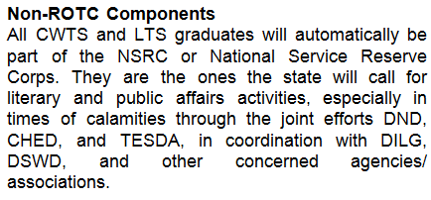


LESSON 1: HISTORICAL & LEGAL BASES OF NSTP

Slide 8
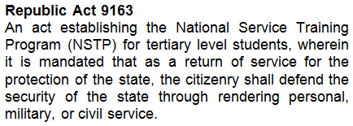
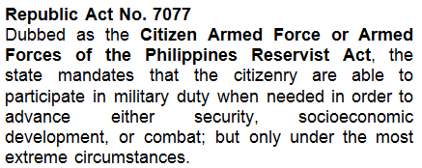
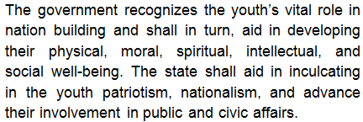
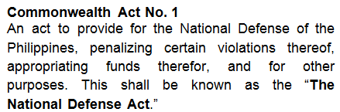

LESSON 1: HISTORICAL & LEGAL BASES OF NSTP

Slide 9
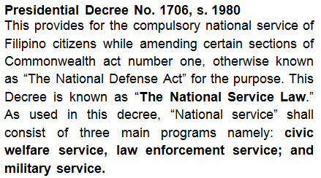

LESSON 1: HISTORICAL & LEGAL BASES OF NSTP

Slide 10
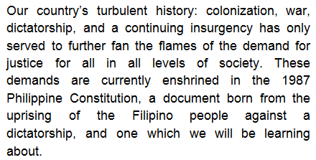
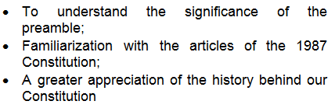
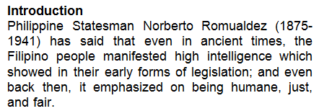
LESSON 2: 1987 PHILIPPINE CONSITUTION

Slide 11


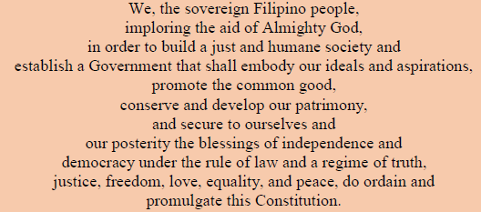
LESSON 2: 1987 PHILIPPINE CONSITUTION

Slide 12

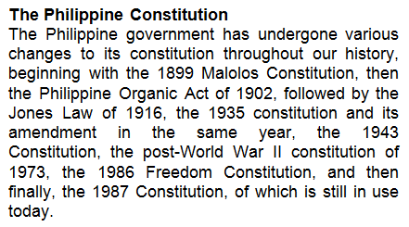



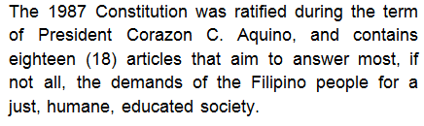
LESSON 2: 1987 PHILIPPINE CONSITUTION

Slide 13
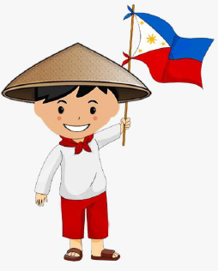
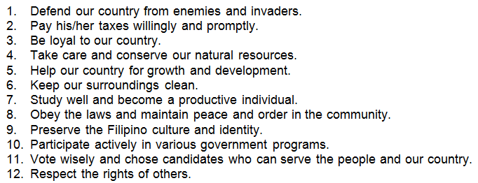
LESSON 2: 1987 PHILIPPINE CONSITUTION

Slide 14
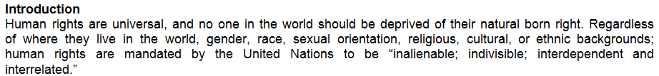
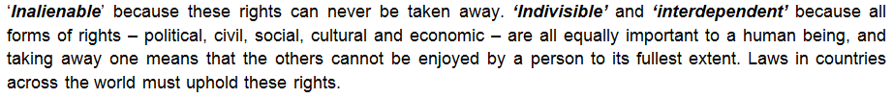
LESSON 3: UNITED NATIONS PRINCIPLE ON HUMAN RIGHTS

Slide 15
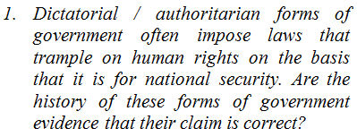

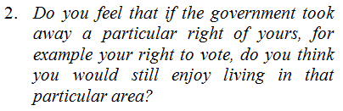
LESSON 3: UNITED NATIONS PRINCIPLE ON HUMAN RIGHTS

Slide 16
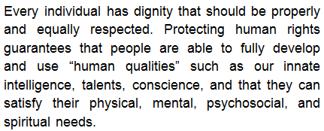


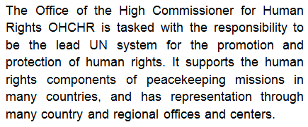
LESSON 3: UNITED NATIONS PRINCIPLE ON HUMAN RIGHTS

Slide 17
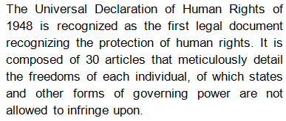

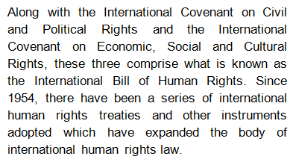
LESSON 3: UNITED NATIONS PRINCIPLE ON HUMAN RIGHTS

Slide 18

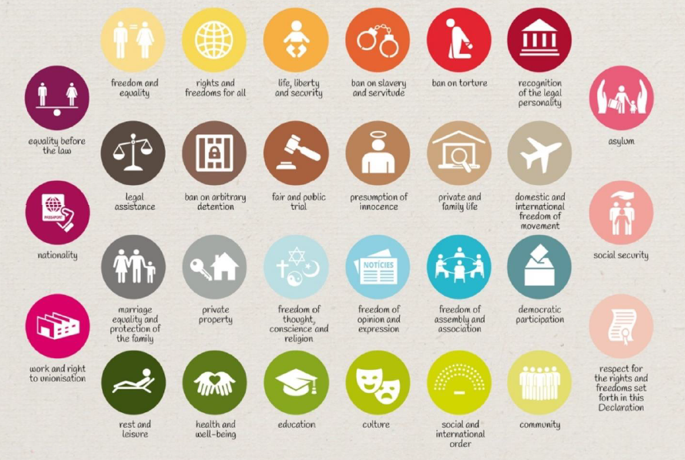

Slide 19
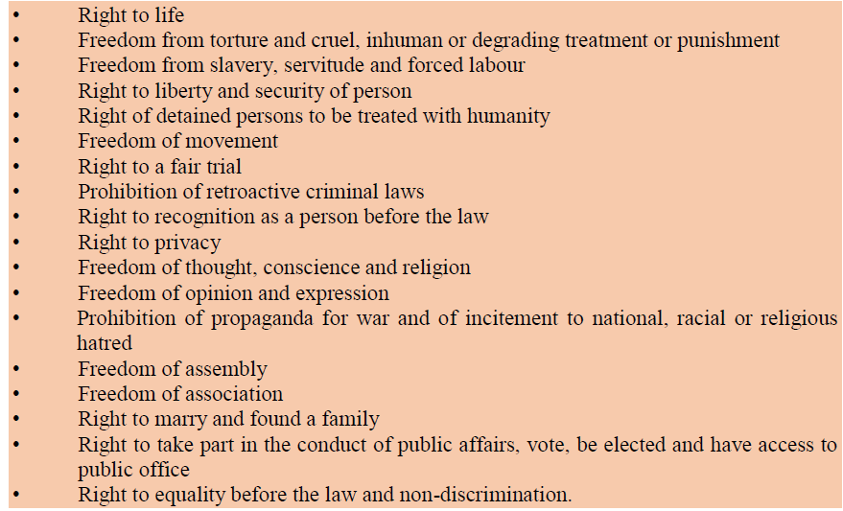
LESSON 3: UNITED NATIONS PRINCIPLE ON HUMAN RIGHTS

Slide 20
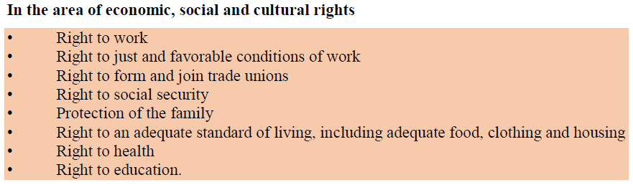
LESSON 3: UNITED NATIONS PRINCIPLE ON HUMAN RIGHTS

Slide 21
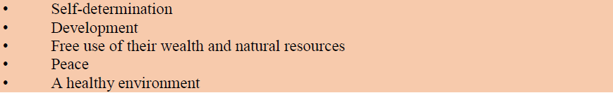

LESSON 3: UNITED NATIONS PRINCIPLE ON HUMAN RIGHTS

Slide 22

LESSON 4: FLAG HERALDIC CODE OF THE PHILIPPINES

Slide 23
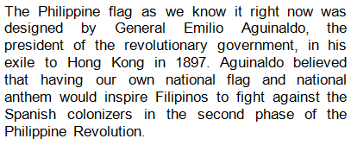
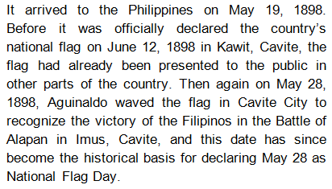
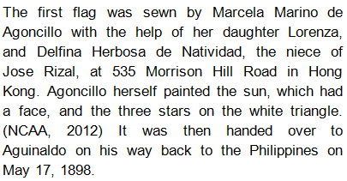
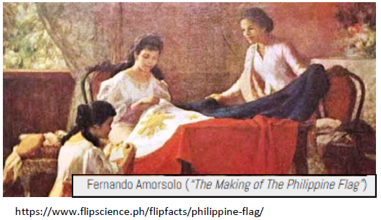
LESSON 4: FLAG HERALDIC CODE OF THE PHILIPPINES

Slide 24
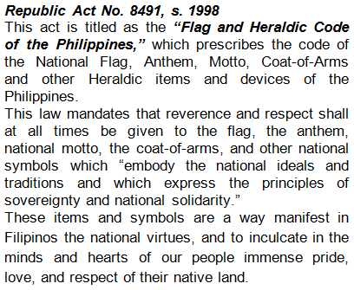

LESSON 4: FLAG HERALDIC CODE OF THE PHILIPPINES

Slide 25


LESSON 4: FLAG HERALDIC CODE OF THE PHILIPPINES

Slide 26
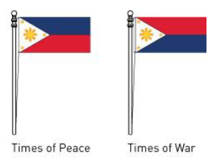
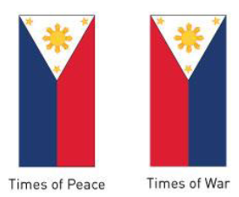
LESSON 4: FLAG HERALDIC CODE OF THE PHILIPPINES

Slide 27
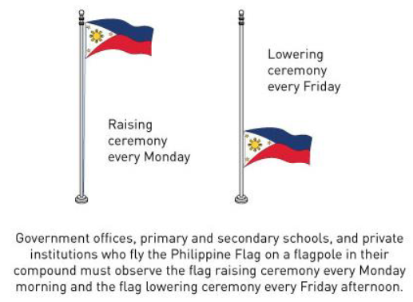
LESSON 4: FLAG HERALDIC CODE OF THE PHILIPPINES

Slide 28
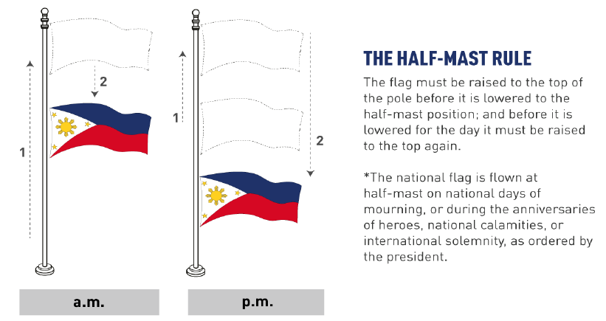
LESSON 4: FLAG HERALDIC CODE OF THE PHILIPPINES

Slide 29

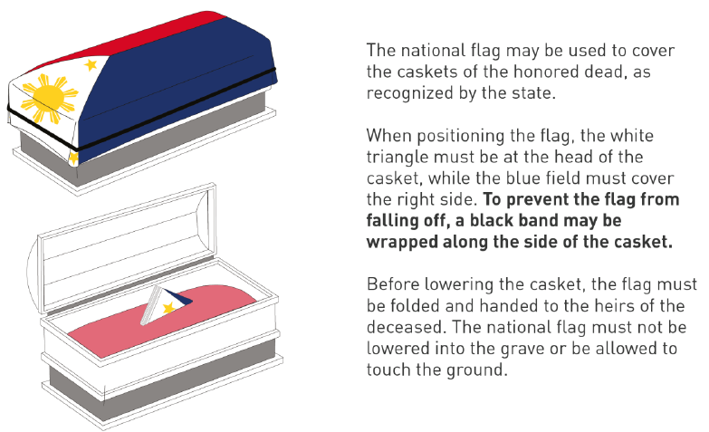
LESSON 4: FLAG HERALDIC CODE OF THE PHILIPPINES

Slide 30
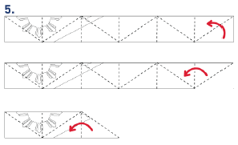

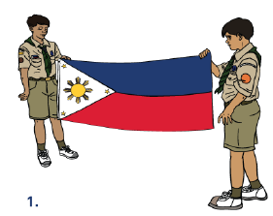
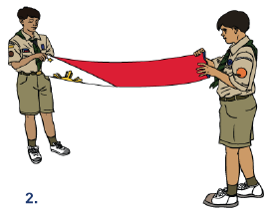






LESSON 4: FLAG HERALDIC CODE OF THE PHILIPPINES

Slide 31
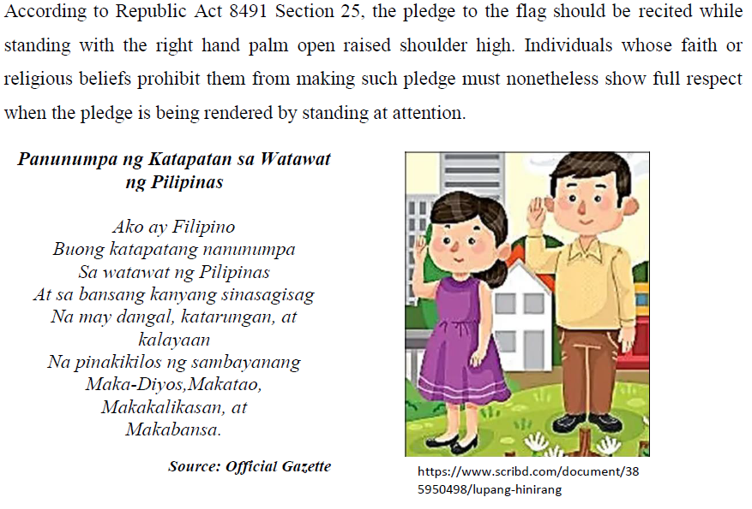
LESSON 4: FLAG HERALDIC CODE OF THE PHILIPPINES

Slide 32

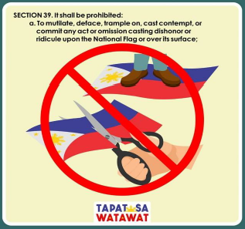
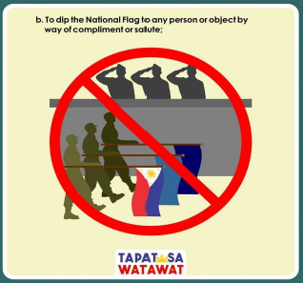
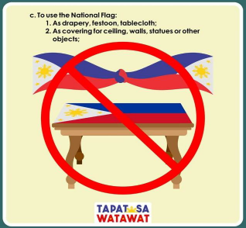
LESSON 4: FLAG HERALDIC CODE OF THE PHILIPPINES

Slide 33



LESSON 4: FLAG HERALDIC CODE OF THE PHILIPPINES

Slide 34



LESSON 4: FLAG HERALDIC CODE OF THE PHILIPPINES

Slide 35



LESSON 4: FLAG HERALDIC CODE OF THE PHILIPPINES

Slide 36



LESSON 4: FLAG HERALDIC CODE OF THE PHILIPPINES

Slide 37


LESSON 4: FLAG HERALDIC CODE OF THE PHILIPPINES

Slide 38

LESSON 4: FLAG HERALDIC CODE OF THE PHILIPPINES

Slide 39

LESSON 5: GOOD CITIZENSHIP VALUES

Slide 40



LESSON 5: GOOD CITIZENSHIP VALUES

Slide 41




LESSON 5: GOOD CITIZENSHIP VALUES

Slide 42





LESSON 5: GOOD CITIZENSHIP VALUES

Slide 43







LESSON 5: GOOD CITIZENSHIP VALUES

Slide 44



LESSON 5: GOOD CITIZENSHIP VALUES

Slide 45





LESSON 5: GOOD CITIZENSHIP VALUES

Slide 46






LESSON 5: GOOD CITIZENSHIP VALUES

Slide 47






LESSON 5: GOOD CITIZENSHIP VALUES

Slide 48





LESSON 5: GOOD CITIZENSHIP VALUES

Slide 49


LESSON 5: GOOD CITIZENSHIP VALUES

Slide 50


LESSON 5: GOOD CITIZENSHIP VALUES

Slide 51


LESSON 6: VOTER CITIZENSHIP EDUCATION

Slide 52



LESSON 6: VOTER CITIZENSHIP EDUCATION

Slide 53






LESSON 6: VOTER CITIZENSHIP EDUCATION

Slide 54
LESSON 6: VOTER CITIZENSHIP EDUCATION

Slide 55







LESSON 6: VOTER CITIZENSHIP EDUCATION

Slide 56






LESSON 6: VOTER CITIZENSHIP EDUCATION

Slide 57
LESSON 6: VOTER CITIZENSHIP EDUCATION

